Slide 1


1st Review
Circularly Polarized Microstrip Patch Antenna Array Ultra Wideband(UWB) Applications
TEAM MEMBERS:
SANJEEVADHARSH B R (927622BEC172)
SANTHOSH KUMAR T (927622BEC176)
SARAVANAKUMAR G (927622BEC178)
SHARAT RHOBAN S (927622BEC184)
GUIDED BY
Dr.P.JEYAKUMAR

Slide 2
INTRODUCTION
In the rapidly evolving field of wireless communication, the demand for higher data rates and increased system capacity has led to the development of advanced technologies like Massive MIMO (Multiple Input Multiple Output).
Massive MIMO uses large antenna arrays, often with hundreds of antennas, to significantly enhance communication capacity by employing aggressive spatial multiplexing.
In this project, a circularly polarized microstrip patch antenna array is designed for ultra-wideband (UWB) applications at 8.25 GHz, with a compact 2x2 array configuration and dimensions of 36.34 mm x 36.34 mm.

Slide 3
LITERATURE SURVEY:
(i) Dual-polarized Turning Torso Antenna Array for Massive MIMO Systems
A compact, dual-polarized antenna array for massive MIMO operation at 3.7 GHz is proposed. The array is arranged from four radiating square patches grouped in three layers of ortho hexagonal rings stacked one a top another.
(ii) Size reduction and performance improvement of a microstrip Wilkinson power divider using a hybrid design technique
A new hybrid technique, which will introduce a novel LC branch for size reduction with improved performance in a Wilkinson power divider, has been introduced.

Slide 4
DESIGN PARAMETERS
S.No | Parameters | Value(in mm)
1 | Patch Radius | 4.575
2 | Height of substrate | 1.6
3 | 50 ohm Feedline Width | 3.06
4 | 70.7 ohm Feedline Width | 1.6
.

Slide 5
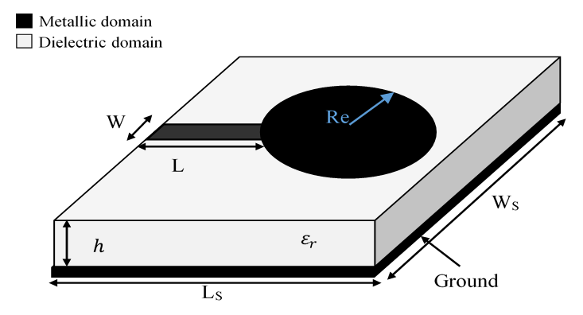
EXISTING SYSTEM:
.

Slide 6
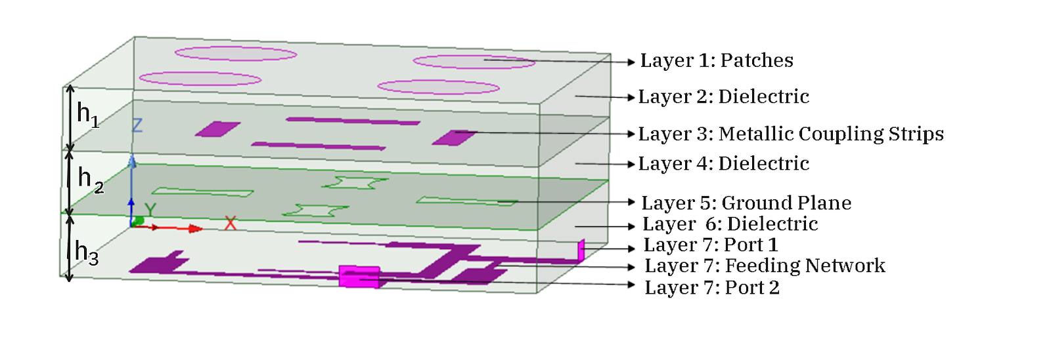
Antenna Design
.
3D View of Circularly Polarised Patch Antenna Array.

Slide 7
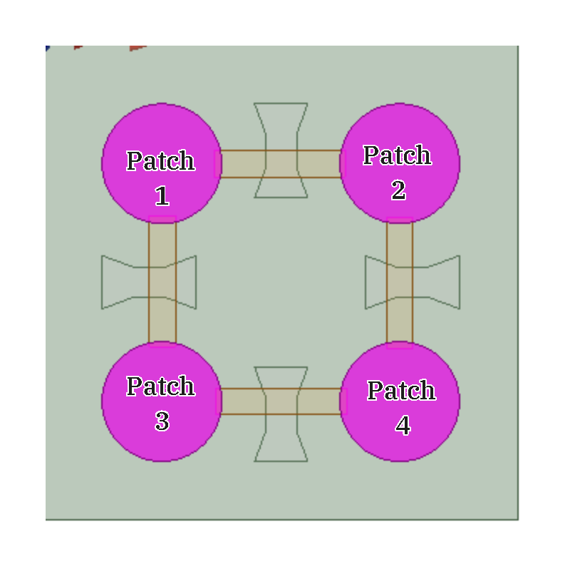
Layout above Ground Plane

Slide 8
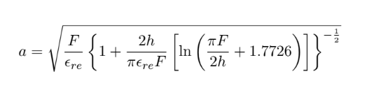
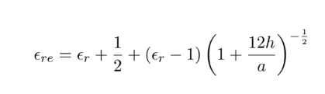
DESIGN PROCEDURE FOR CIRCULAR PATCH

Slide 9
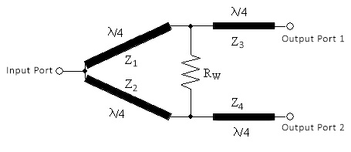
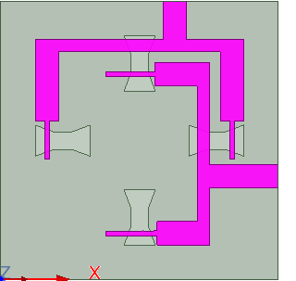
DESIGN PROCEDURE FOR WILKINSON POWER DIVIDER

Slide 10

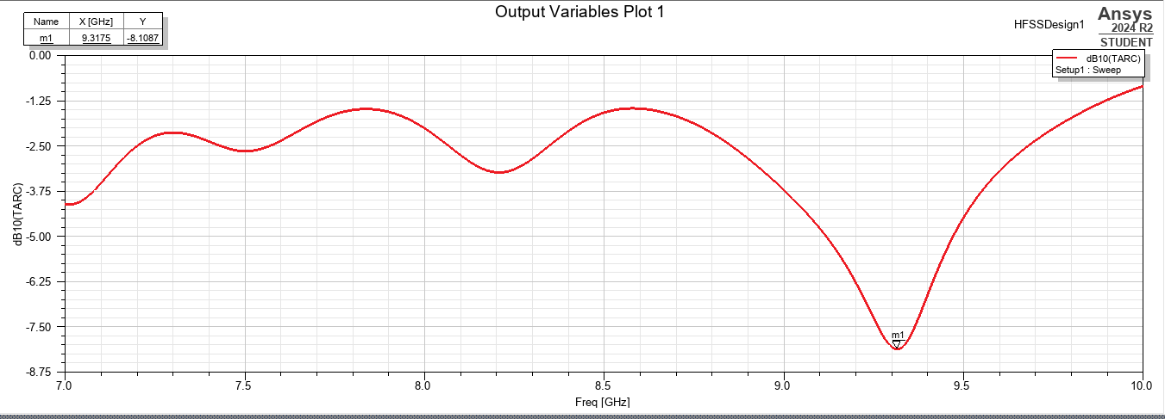
MIMO ANTENNA PARAMETERS
TOTAL ACTIVE REFLECTION COEFFICIENT(TARC):
.
The Plot Between TARC (dB) and Frequency (GHZ)

Slide 11

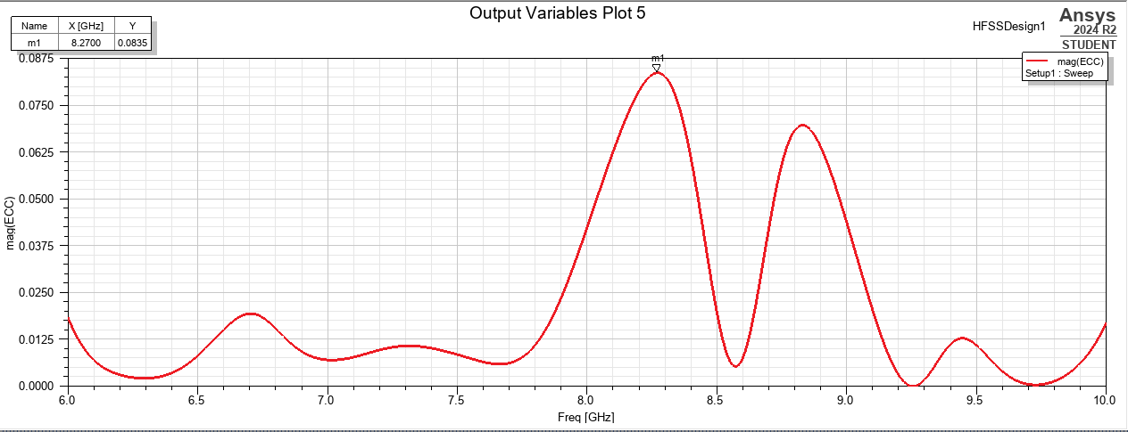
ENVELOPE CORRELATION COEFFICIENT(ECC)
The Plot Between TARC (dB) and Frequency (GHZ)

Slide 12

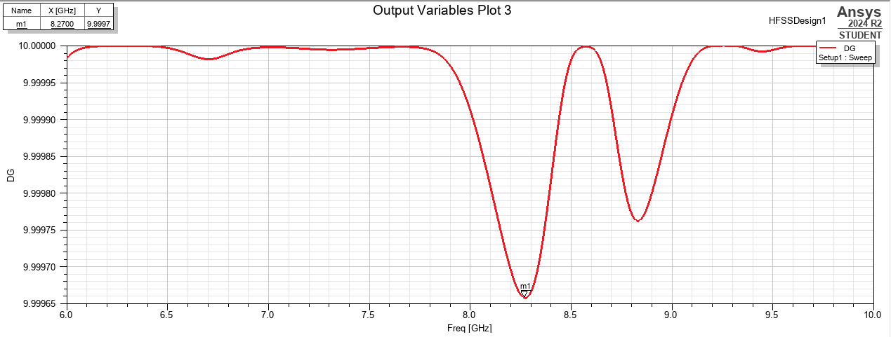
DIVERSITY GAIN (DG)
The plot between Diversity gain and Frequency

Slide 13

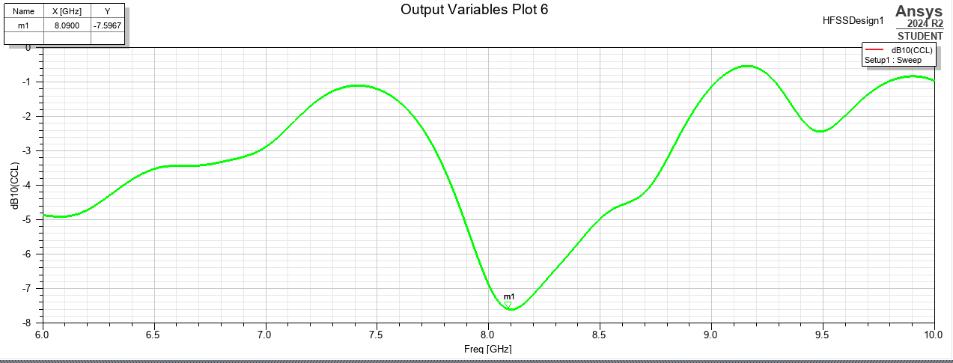
CORRELATION COEFFICIENT
The Plot Between CCL (bps/Hz) and Frequency (GHZ)

Slide 14
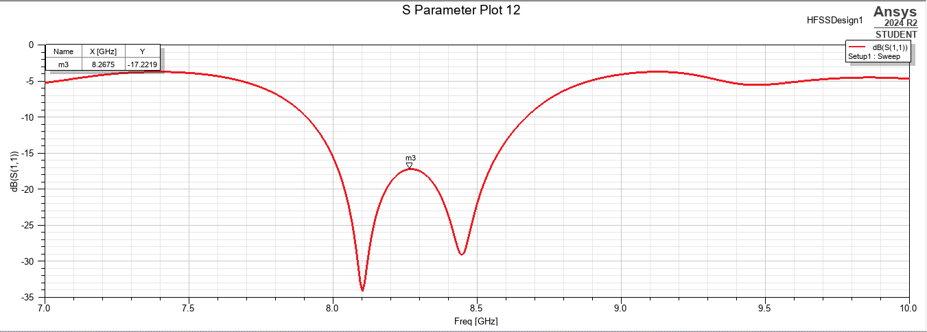
RESULTS AND DISCUSSION
FREQUENCY RESPONSE
The result obtained for the reflection coefficient S11 parameter is 8.26 GHz with a bandwidth of 746 MHz.

Slide 15
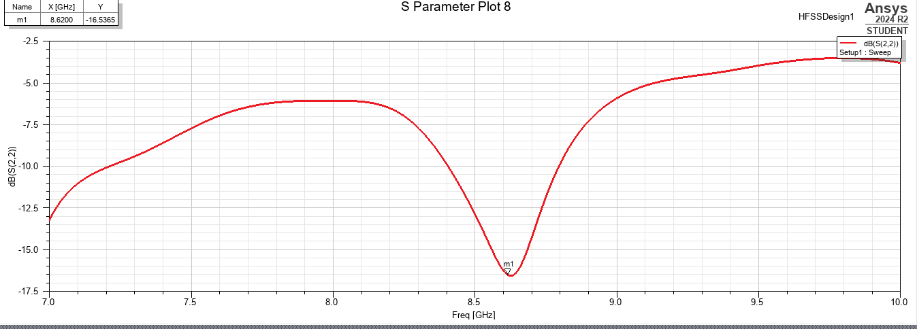
The result obtained for the reflection coefficient S22 parameter is 8.62 GHz with a bandwidth of 400 MHz.

Slide 16
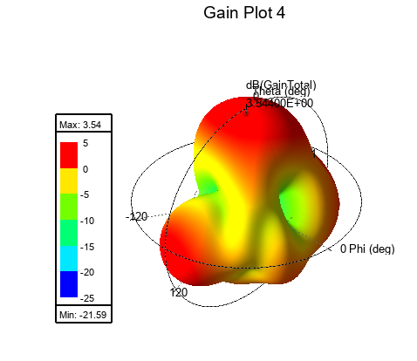
GAIN
The overall gain of the proposed antenna. The total gain obtained by the proposed antenna is 3.54dB.

Slide 17
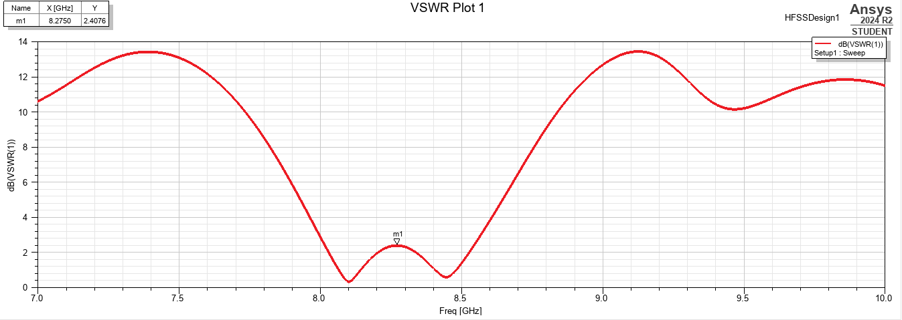
VOLTAGE STANDING WAVE RATIO(VSWR)
The VSWR plot of the proposed antenna .The overall value of Voltage Standing Wave Ratio is at 8.27GHz.

Slide 18
REFERENCES
[1] Circularly polarized patch antenna array fed by coplanar waveguide. IEEE
Transactions on Antennas and Propagation, 52(6):1607–1609, 2004.
[2] Slotted microstrip antennas for circular polarization with compact size. IEEE
Antennas & Propagation Magazine, 55(2):124–137, 2013.
[3] A wideband circularly polarized stacked slotted microstrip patch antenna. IEEE
Antennas and Propagation Magazine, 55(6):84–99, 2013.
[4] Circularly polarized patch antenna array at 24 GHz for radar applications. In
2018 26th telecommunications forum (TELFOR), pages 1–4. IEEE, 2018.

Slide 19
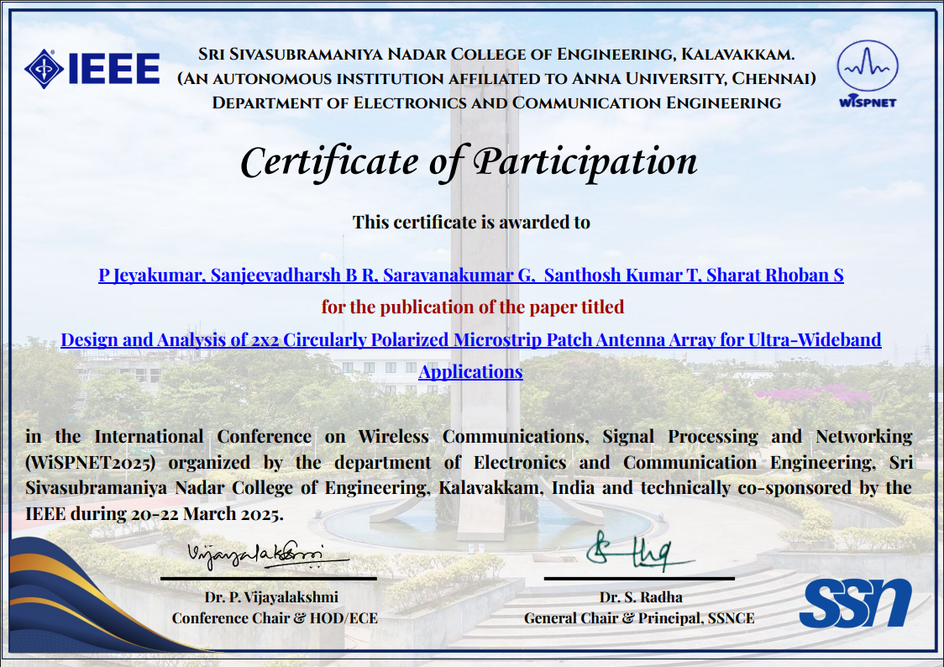
PROJECT OUTCOME

Slide 20

.

